Slide 1
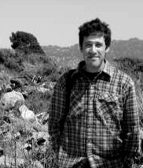
Coalescent models with linked selection
Graham Coop and Peter Ralph
Dept. of Evolution and Ecology
UC Davis

Slide 2
Outline
Genome-wide evidence for hitchhiking
Multiple merger coalescent of full sweeps
A multiple merger model of recurrent partial sweeps
A simultaneous multiple merger model of recurrent soft sweeps

Slide 3
The effect of selective sweeps on linked neutral variants
Maynard Smith and Haigh, Kaplan et al ‘89, etc
sweep
recovery
Reduced diversity
high frequency derived
alleles
New mutations
lead to a skew towards
rare alleles
Selective sweep results in a characteristic reduction in coalescent time at linked neutral sites. Also a distortion in the genealogical tree towards external branches and away from internal branches.
Background selection can also lead to a reduction in diversity,
but lead to only a weak skew towards rare alleles

Slide 4
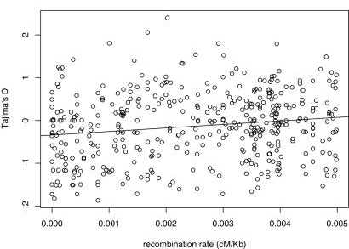
Evidence for linked
selection in Drosophila
melanogaster
e.g. Shapiro et al 2007
π =Syn. Diversity (%)
Recombination rate cM/kb
Tajima’s D
Recombination rate cM/kb
Notes:
Under a model where selected alleles recurrently sweep we expect:
lower diversity in low recombination regions and a skew towards rare alleles
This prediction

Slide 5
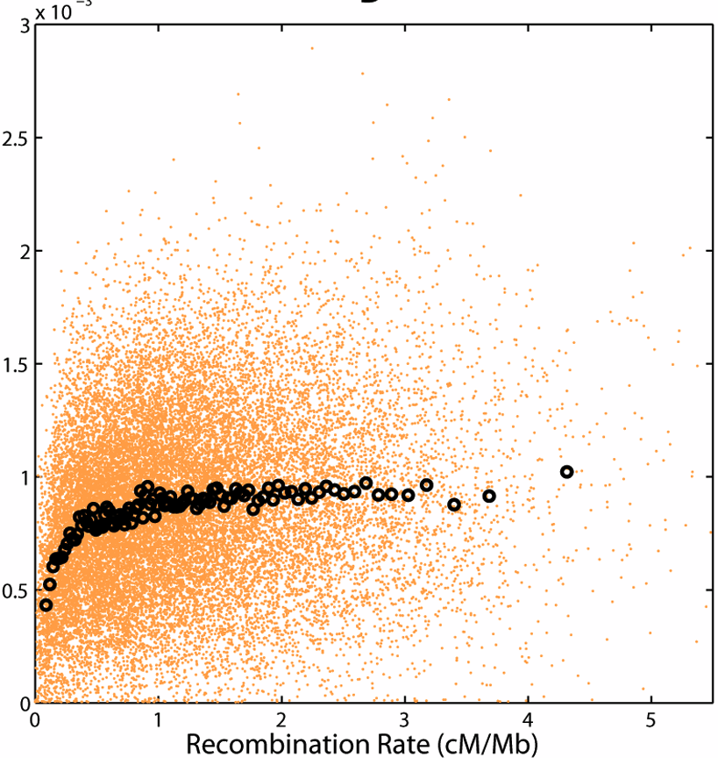
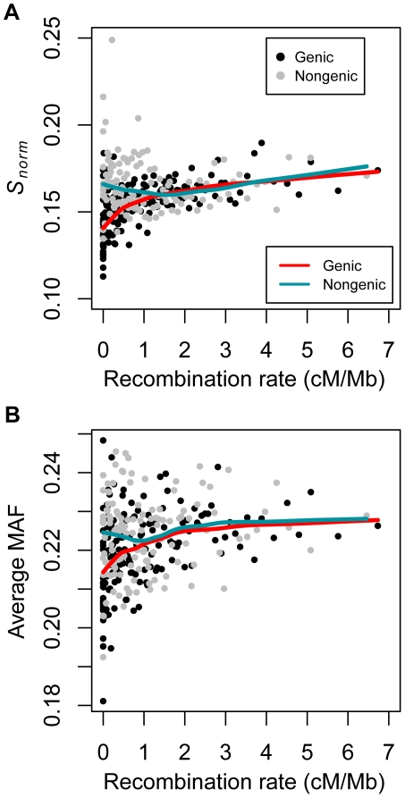
Evidence for variation-reducing selection in humans
But not clear what mode of linked selection acts.
Polymorphism, π
Average minor allele frequency
Cai et al. 2009
^{Lohmueller et al., 2011}

Slide 6
Time-scale of selective sweep = t =2log(2N_{e})/s
Probability of failing to recombine off q=exp(-rt/2)
Probability that i out of k lineages are forced to coalesce ~ Binom(k,q)
Maynard Smith and Haigh, Barton, 1998, Durrett and Schweinsberg, 2004, etc
time
unfavored allele
recombination
2log(2N_{e})/s
favored allele
present
0
Frequency of favored/unfavored allele
1
Barton, 1998; Durrett and Schweinsberg, 2004; Etheridge et al., 2006; Pfaffelhuber et al., 2006,…

Slide 7
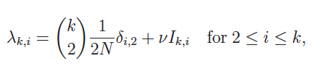
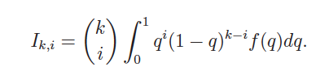
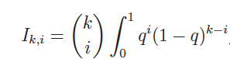
Sweeps occur at rate ν with
q ~ f(q) a iid r.v. across sweeps
i lineages out of k lineages
forced to coalesce at rate:
i lineages coalesce out of k at rate
Multiple mergers coalescent
Gillespie ‘00, Durrett & Schweinsberg 05
Lambda coalescent:

Slide 8
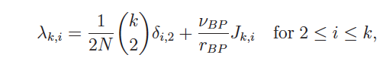
Multiple mergers coalescent
Homogeneous sweeps at rate v_{BP},
recombination at rate r_{BP}.
Then i out of k lineages coalesce at rate:
Kaplan et al 1989,
Durrett & Schweinsberg 05
Kaplan et al. (1989) and Stephan et al. (1992)
Notes:
J_{k,i}= {k \choose i} \int_0^{\infty} q(r)^i(1-q(r))^{k-i} dr

Slide 9
Multiple mergers coalescent
π =Syn. Diversity (%)
r_{BP} = Recombination rate cM/kb
Kaplan et al. (1989) and Stephan et al. (1992)
Notes:
J_{k,i}= {k \choose i} \int_0^{\infty} q(r)^i(1-q(r))^{k-i} dr

Slide 10
What if most newly arisen selected alleles do not sweep to rapidly fixation?
E.g. due to changing environment or genomic background (Due to parallel mutation, other standing variation etc)
Pritchard, Pickrell, Coop 2010
Pennings and Hermisson, 2006a,b; Chevin and Hospital, 2008; Ralph and Coop, 2010, Innan and Kim, 2004; Hermisson and Pennings, 2005; Przeworski et al., 2005

Slide 11
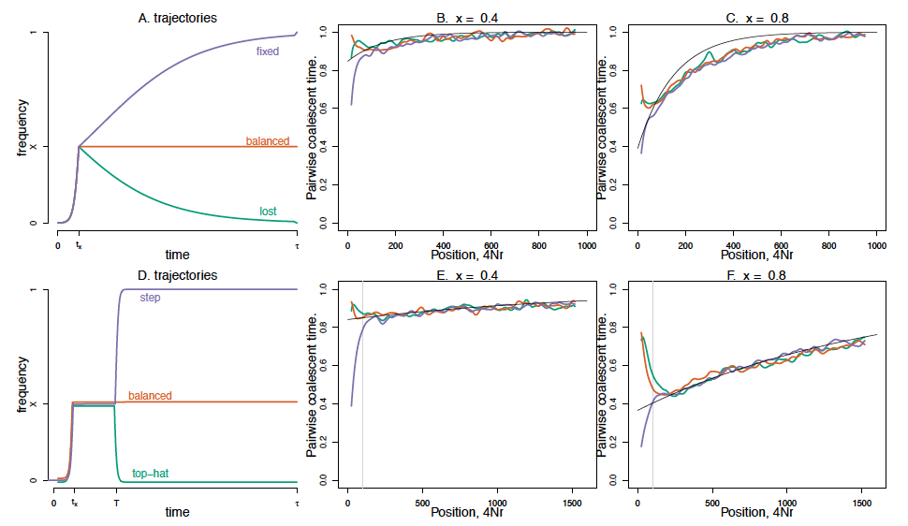
What if most newly arisen selected alleles do not sweep to rapidly fixation?
E.g. due to changing environment or genomic background (Due to parallel mutation, other variation etc)

Slide 12
B. Coalescent with trajectory
The derived allele arose τ
Generations ago
0
X(t) is the frequency of the
Derived allele at time t
Conditions on trajectory:
Selected allele initially
quickly increases
in frequency. If it approaches
0 or 1 it does not renter the
Population.
τ

Slide 13
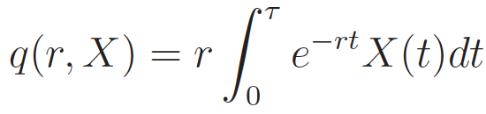
B. Coalescent with trajectory
0
Imagine a neutral site
a genetic distance r away from
the selected locus
t
Probability that the lineage is of the derived type at time 0 =
For r τ >>1
τ

Slide 14
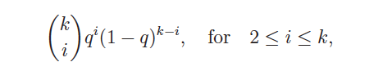
B. Coalescent with trajectory
0
Probability that i out of k lineages are force to coalesce is binomial:
Assuming that the all coalescence
happens close to time 0, rN >> 1
τ
Notes:
Think about a pair of lineages.

Slide 15
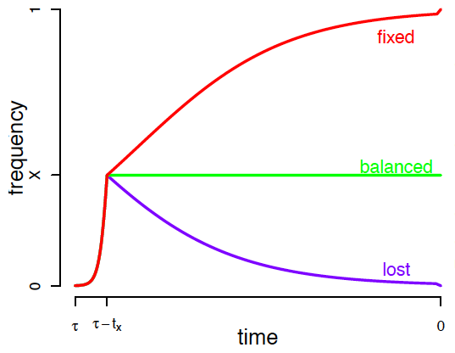
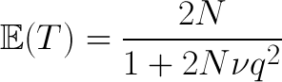
Simple trajectories
Selected allele moves quickly from 1/2N to x in time t_{x}
Then stays at x, or goes to fixation, or loss on a slower time-scale
(e.g. with selection coefficient s₂, -s₂, or 0 respectively)
Also holds for other
trajectories when
r >> s₂
2
0 t_{x}
τ
Notes:
q \approx x e^{-rt_x}

Slide 16
x=0.4
t_{x} /2N = 0.0053
τ/2N = 0.05
x=0.8
t_{x} /2N = 0.00053
τ/2N = 0.05
T/2N = 0.02

Slide 17
A. Multiple mergers coalescent
B. Coalescent with trajectory
0

Slide 18
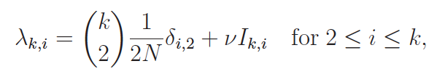
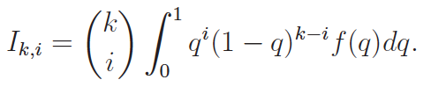
Recurrent sweep process
Assume Neutral pairwise rate of coalescence: 1/(2N)
Sweeps happen at rate ν
At a fixed position, with constant q
Total rate of coalescence of i out of k:
Inspired by Gillespie ‘00, Durrett & Schweinsberg 05
Notes:
\mathbb{E}(T)=\frac{2N}{1+2N\nu q^2}

Slide 19
2
For our simple approximation
x=0.8
2
4Nν=1,
4Nν=2
4Nν=4
Approx.
Recurrent step traj.
Recurrent top hat traj.
Notes:
traj<-read.table("ex_recurr_lost.traj",as.is=T,skip=7); plot(traj,type="l",xlim=c(0.2,0.35),ylim=c(0,1),xlab="Time",ylab="Frequency");
traj<-read.table("recurr_fix.traj",as.is=T,skip=7); plot(traj,type="l",xlim=c(0.3,0.6),ylim=c(0,1),xlab="Time",ylab="Frequency");dev.copy2eps(file="../figures/stalled_S.eps")

Slide 20
Run mssel for recurrent top-hat trajectories for 20 sequences
2 r/s log(2N) = y= 0.61
Calculate for partial sweep coalescent q = x e^{-y}
Fraction of singleton sites
Relative level of diversity
Notes:
S=6000
R=600

Slide 21
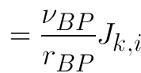
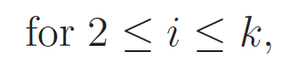
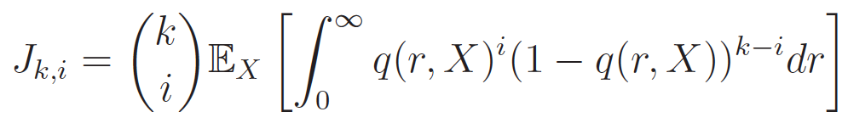
Homogeneous sweeps at rate ν_{BP} ,recombination at rate r_{BP}.
Then i out of k lineages coalesce at rate:
Where J_{k,i} depend only on the form taken by trajectories
So rate of coalescence controlled by
E.g. for our simple trajectory J_{k,i} is a function of x (freq. sweeps achieve)
and so number of lineages forced to coalesce by x (or distribution on x).
Notes:
\nu \mathbb{E}\left( {k \choose i} q^i(1-q)^{k-i} \right) = \frac{\nu_{BP}}{r_{BP}}J_{k,i}

Slide 22
Data from
Drosophila melanogaster
(Shapiro et al 2007)
π =Syn. Diversity (%)
2Nv_{BP} J_{2,2}=7x10⁻⁹
Assuming none of the reduction is due to Background Selection
r_{BP} = Recombination rate cM/kb
Under our simple partial sweep model: J_{2,2} = x²/t_{x}
t_{x} = 1000 gens (s~0.1%), N=10⁶, v_{BP} x² = 3x10⁻¹³
x = 100% 20% 5%
v_{BP}= 3e-13 8e-12 1e-10 per generation
Notes:
\mathbb{E}(\pi)=4Nu\frac{r_{BP}}{r_{BP}+2N\nu_{BP} (x^2/t_x)}
Under a model where selected alleles recurrently sweep we expect:
lower diversity in low recombination regions and a skew towards rare alleles
This prediction

Slide 23
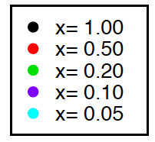
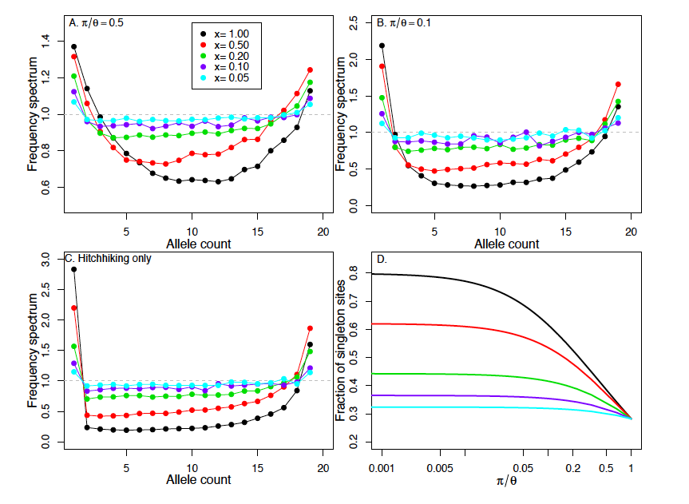
For same reduction in diversity we can get very different
distortions to frequency spectrum
Under Kingman coalescent
k
Notes:
F^N_{n,k} = \mathbb{E}(\textrm{Fraction of sites seen in k out of n})

Slide 24
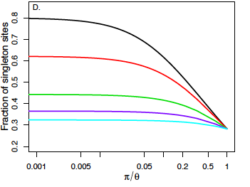
For same reduction in diversity we can get very different
distortions to frequency spectrum
k

Slide 25
Selection on multiple mutations either standing or new
Soft Sweeps
Selection on standing variation
Hermisson and Pennings 05, Pennings and Hermisson 06
Przeworski, Coop and Wall 2005
Kim and Innan 05

Slide 26
Soft Sweeps
Pennings and Hermisson showed:
Mutation rate at selected site =ρ
At selected site: Lineages assigned to coalescent families
(tables) following infinite alleles model with param. 4Nρ
At distance r away lineages recombine off, with probability q, and so escape coalescence.
Remaining lineages assigned to coalescent families
q=e^{-rt}
Where t= time of sweep
Hermisson and Pennings 05, Pennings and Hermisson 06

Slide 27
Recurrent Soft Sweeps
Neutral coalescence at rate 1/(2N)
Sweeps occur at rate ν_{BP} homogeneously
along sequence recombining at rate r_{BP}
i out of k lineages caught in sweep at rate:
The i lineages are then forced into coalescence families
according to infinite alleles model with parameter 4Nρ
Notes:
{k \choose i} \frac{\nu_{BP}}{t\, r_{BP}} \int_0^{\infty} \left(e^{-r} \right)^{i}\left(1-e^{-r}\right)^{k-i} dr

Slide 28
Recurrent Soft Sweeps
/FjN
k
Notes:
F_{20,k}/F^N_{20,k}
\mathbb{E}(\pi)=4Nu\frac{r_{BP}}{r_{BP}+2N\nu_{BP}J_{2,2}/(1+\theta)}

Slide 29
Conclusions
A broad range of linked selection models can be approximated by coalescent models with multiple mergers
Range of biological models of linked selection depressingly large and predictions overlap.
Idea: Rather than estimating one model why not estimate rates of different types of coalescence across genome.

Slide 30
What we need
Given that the rate of sweeps differs across the genome, what can we hope to learn about the multiple merger process?
We need theory to predict frequency spectra and haplotype patterns under these models.
What set of statistics are most informative?
What set of coalescent processes can we hope to distinguish?

Slide 31
Thanks
Peter Ralph
Thanks to Yaniv Brandvain, Chuck Langley, Molly Przeworski,
Alisa Sedghifar, and Guy Sella for helpful conversations

Slide 32
For our simple approximation
Simulate mssel with either
Loss trajectory motif
fixed trajectory
motif
Repeat motif with waiting time ~Exp(v) between them
Notes:
traj<-read.table("ex_recurr_lost.traj",as.is=T,skip=7); plot(traj,type="l",xlim=c(0.2,0.35),ylim=c(0,1),xlab="Time",ylab="Frequency");
traj<-read.table("recurr_fix.traj",as.is=T,skip=7); plot(traj,type="l",xlim=c(0.3,0.6),ylim=c(0,1),xlab="Time",ylab="Frequency");dev.copy2eps(file="../figures/stalled_S.eps")

Slide 33
Evidence for variation-reducing selection in humans
But not clear what mode of linked selection acts.
Polymorphism, π
Average minor allele frequency
Cai et al. 2009
^{Lohmueller et al., 2011}

Slide 34
Matching the reduction in pi the distortion to the site frequency spectrum
Frequency selected alleles
sweep to
100%
50%
20%
5%
Fraction of singletons sites
Sample size =20
Recombination

Slide 35
r
Fail to recombine off derived background,
forced to coalesce
0
Soft sweep model due to
Parallel mutation during sweep
Notes:
All line

Slide 36
Conclusions
P

Slide 37
Data from Humans
Hellmann et al using similar data
Estimated π₀ =1.6x10⁻³ , α = 6 x 1 0 ⁻¹ ¹
Polymorphism
Assuming none of the reduction
is due to BS
e.g. Cai et al 2009
Rate of recombination (cM/Mb)
α= 2Nv_{BP} (x²/t_{x})
t_{x} = 1000 (s~1%)
N=10000
v_{BP} x² = 3 x 10⁻¹²
x = 100% 50% 20% 5%
v_{BP}= 3e-12 1e-11 8e-11 1e-09 !!!
Note humans need a high sweep
rate despite smaller effect of HH
Notes:
Under a model where selected alleles recurrently sweep we expect:
lower diversity in low recombination regions and a skew towards rare alleles
This prediction

Slide 38
Solid coloured line recurrent loss trajectory.
Dashed coloured line recurrent fix trajectory
t_{x} /2N = 0.0015
Pauses for 0.02 (2N generations)

